Slide 1
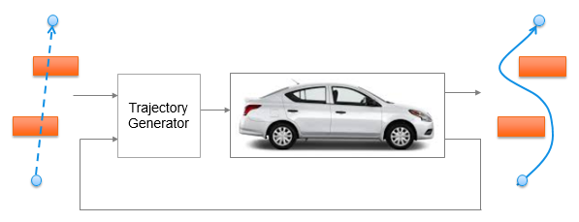
Trajectory Generation in High Density Environment
Mid-Term Review
Suvo Ganguli
Alberto Speranzon
Apr 2018

Slide 2
Overview
Trajectory Generation in 2-dimensional space
Laplacian Planner
Model Predictive Control (MPC)
Tradeoff Parameters
Summary of Results
Tradeoff Data and Charts

Slide 3
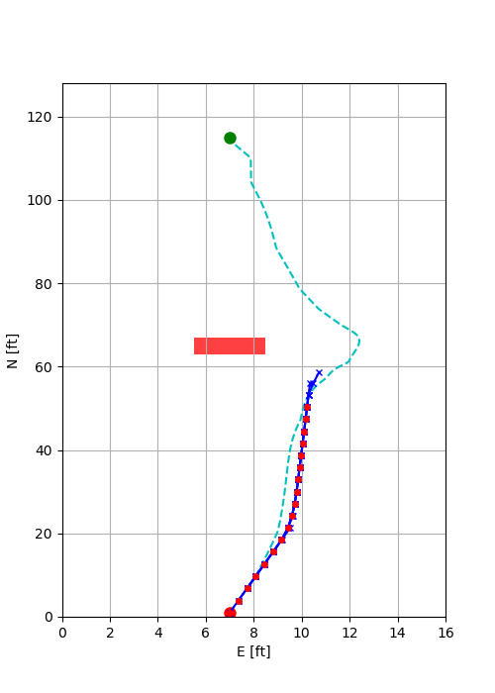
Trajectory Generation
There are two steps to the trajectory generation:
Laplacian Planner Trajectory Generation
Provides an initial solution for the MPC Trajectory Generator
Solves for a potential flow from start point to end point avoiding obstacles
Does not take into account vehicle dynamics and constraints
MPC Trajectory Generation
Solves an optimization problem to generate a short trajectory
Moves one step along the trajectory and resolves the optimization problem
Takes into account vehicle dynamics and constraints

Slide 4
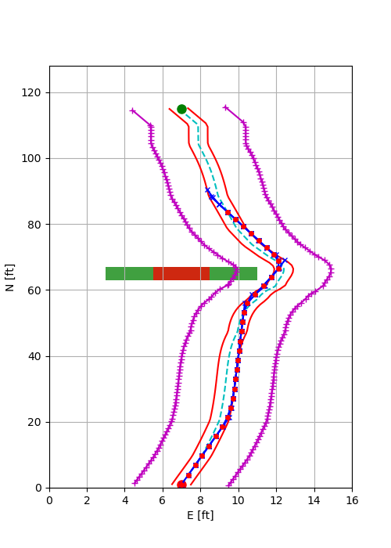
MPC Trajectory Generation
Minimize cost
Velocity error
Lateral path error
Control signals
Satisfy vehicle dynamics and constraints
Satisfy other constraints
Trajectory constraints
Terminal constraints
Lateral Acceleration constraint
Laplacian trajectory
Terminal constraints
MPC trajectory
Obstacle
Safety Margin
Trajectory constraints

Slide 5
Overview
Trajectory Generation in 2-dimensional space
Laplacian Planner
Model Predictive Control (MPC)
Tradeoff Parameters
Summary of Results
Tradeoff Data and Charts

Slide 6
Tradeoff Parameters
Our goal is to trade off the CPU time (CT) with
Trajectory Parameters
Number of MPC time steps = N
MPC time step = T
Model Complexity
Number of states = ns
Obstacle density
Number of obstacles = no
Model Complexity
4 state model
6 state model
Obstacle Density is measured by the number of obstacles which are
Static
Placed to obstruct the line of sight from the start point to the end point
CT
vs
N | T (sec) | ns | no
4 | 0.2 | 4 | 0
6 | 0.4 | 6 | 1
8 |  |  | 2
10

Slide 7
Overview
Trajectory Generation in 2-dimensional space
Laplacian Planner
Model Predictive Control (MPC)
Tradeoff Parameters
Summary of Results
Tradeoff Data and Charts

Slide 8
Summary of Results
CPU Time (CT) variation with the tradeoff parameters – number of trajectory steps (N), number of obstacles (no) and number of states (ns) are as follows:
CT increases with N as 2^{N}
CT increases with no as e^{-no}
CT increases linearly with T
CT decreased from ns = 4 to ns = 6
Increase in horizon distance leads to:
Smoother trajectory
Increase in comfort level
Decrease in control effort
This is because with increase in horizon distance, control action can be taken earlier.
This is at the cost of increase in computation time
Analysis not shown in this slide deck
Key Takeaway

Slide 9
Overview
Trajectory Generation in 2-dimensional space
Laplacian Planner
Model Predictive Control (MPC)
Tradeoff Parameters
Summary of Results
Tradeoff Data and Charts

Slide 10
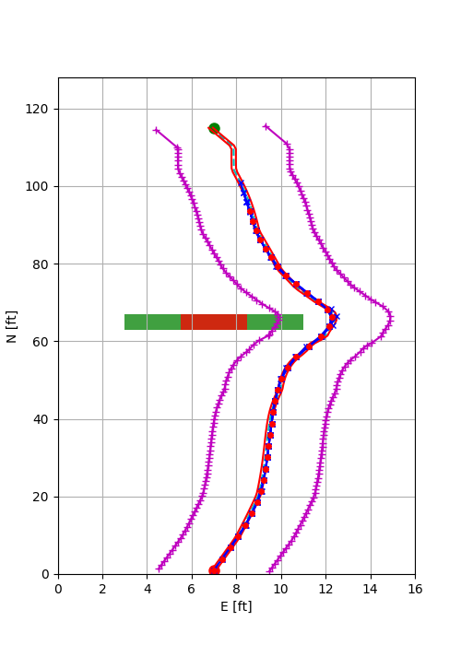
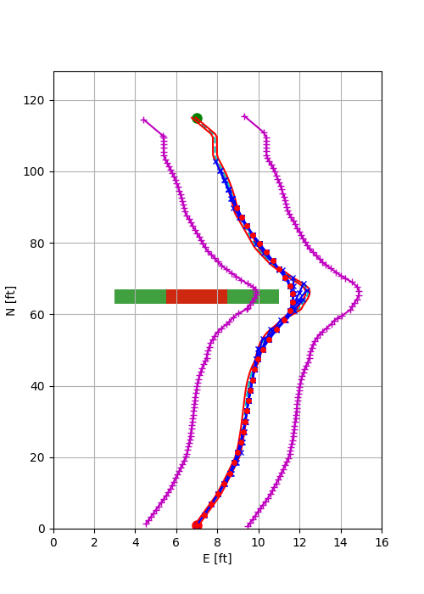
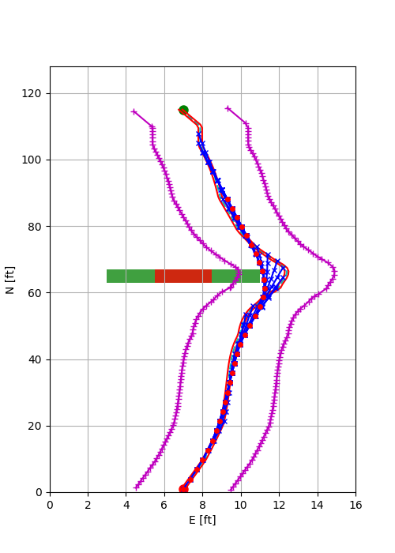
Trajectory Variation with No. of Time Steps
With number of states = 4 and number of obstacles = 1, as we increase the number of time steps = 4, 6, 8, we observe that the trajectory gets smoother
If a “ribbon” being pulled along a circuitous path, the longer the ribbon, the wider the turns.
N = 4
N = 6
N = 8

Slide 11
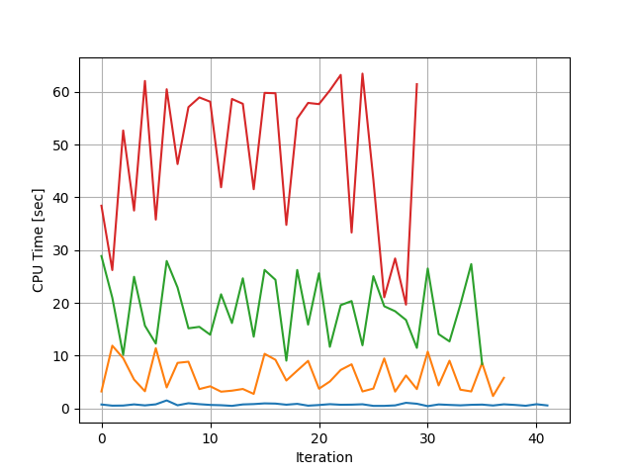
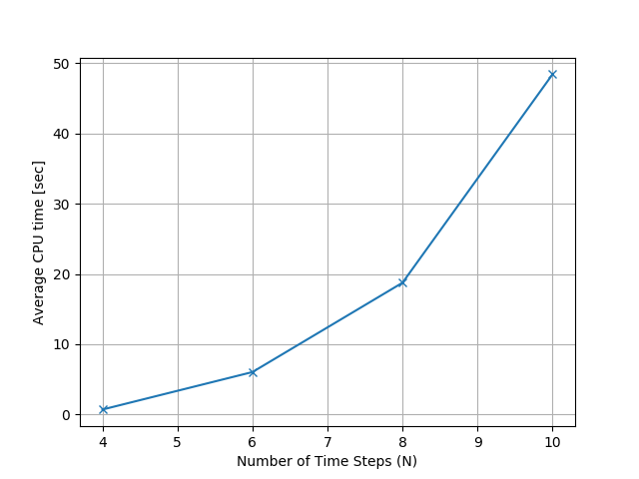
CPU Time vs No. of Time Steps (CT vs N)
CPU mean time increases with N as 2^{N}
N=10
N=8
N=6
N=4

Slide 12
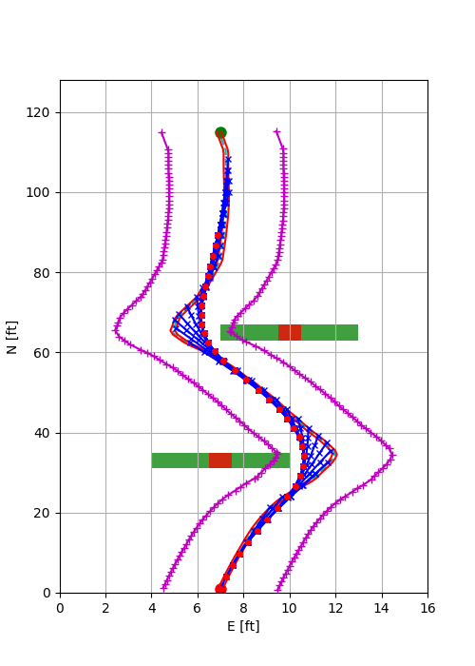
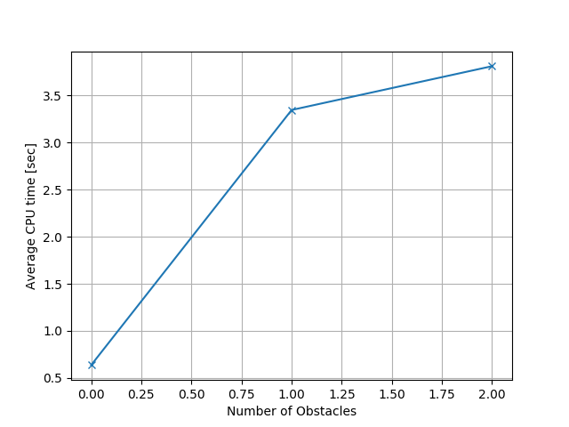
CPU Time vs No. of Obstacles (CT vs no)
CPU mean time increases with N as k(1-e^{-bno}) as the number of constraints are active for a longer duration
1 Obstacle
2 Obstacles
9x

Slide 13
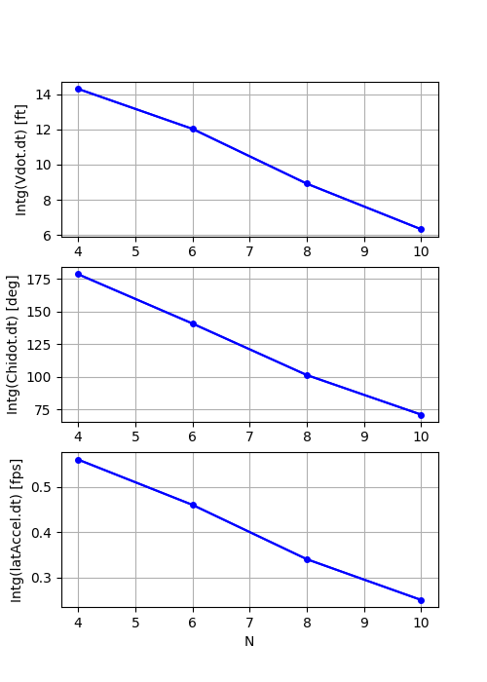
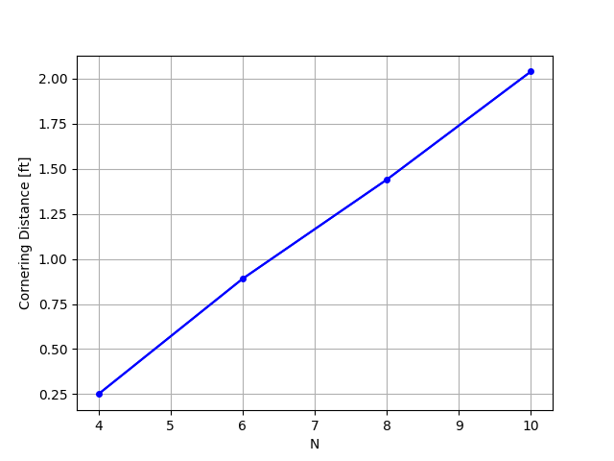
Tradeoff Curves for Design – 1 of 3
Increase in N (equivalent to horizon distance) leads to:
Smoother trajectory
Increase in comfort level
Decrease in control effort
At the cost of
Increase in computation time
Control Effort
Computation time
Trajectory Smoothness
Control Effort
1
Comfort Level

Slide 14
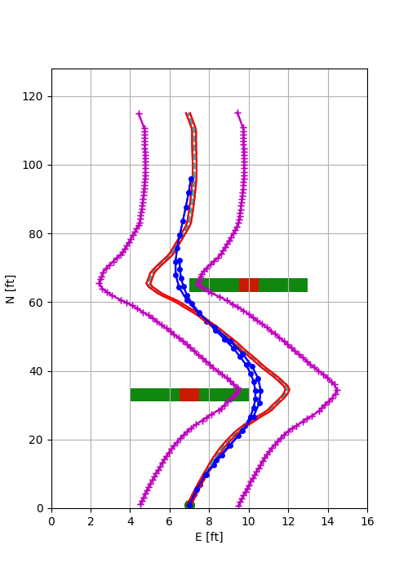
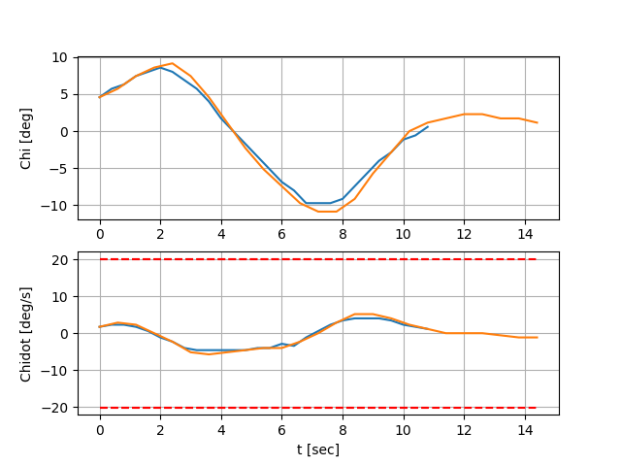
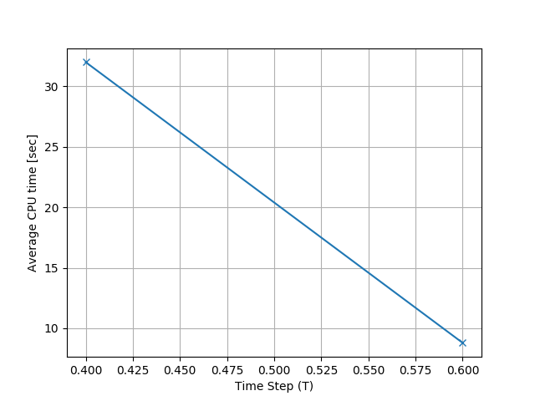
Tradeoff Curves for Design – 2 of 3
The same horizon length can be formed with different combinations of N and T – for e.g., (N = 9, T = 0.4) vs (N = 6, T = 0.6)
Plots below show that control effort and the trajectory smoothness are similar. However the Computation Time is 4X more for (N = 9, T = 0.4)
N=6, T = 0.6
N=9, T = 0.4
4X
N=9, T = 0.4
N=6, T = 0.6

Slide 15
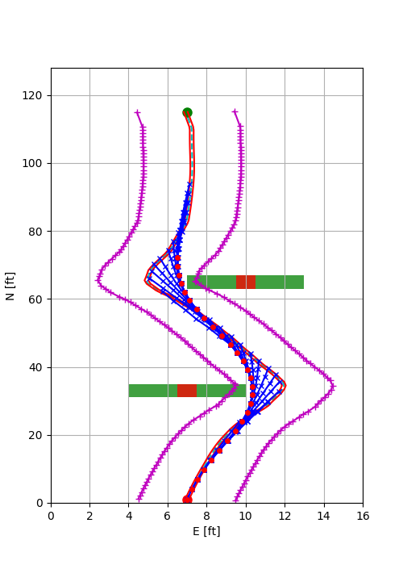
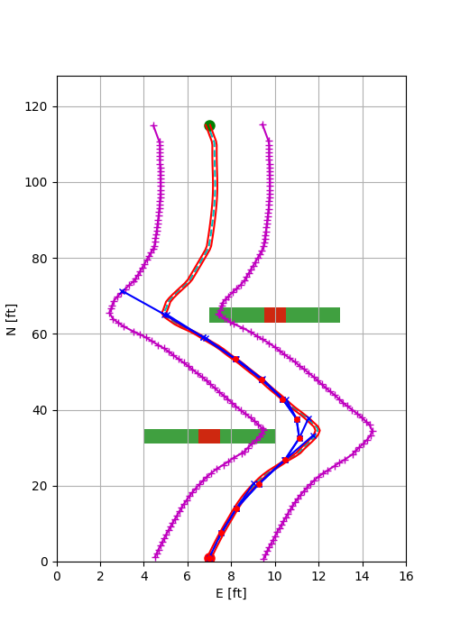
Tradeoff Curves for Design – 3 of 3
Too large a time step can lead to infeasible solution as the required heading change can be large and the solution for the nonlinear optimization cannot be guaranteed
(N = 9, T = 0.4)
(N = 4, T = 0.9)
requires large heading change
requires small heading change

Slide 16
Extra Slides

Slide 17
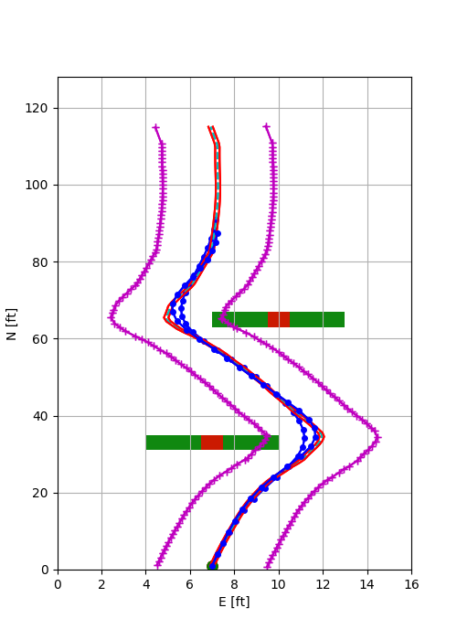
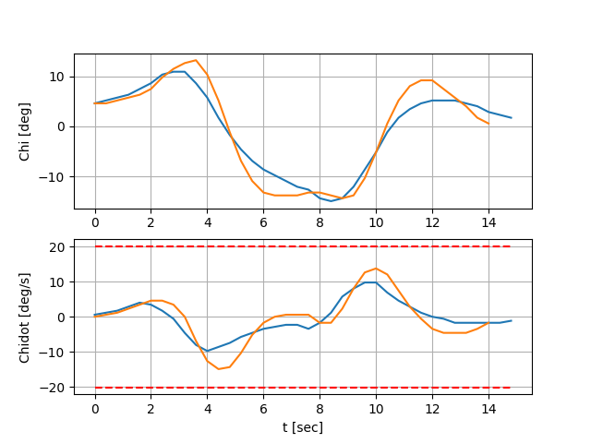
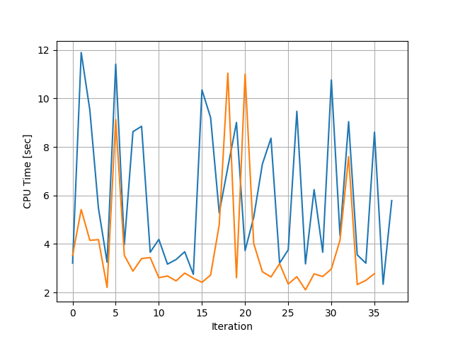
Number of Solver Iterations
CT for ns = 6 takes less time than ns = 4 (counter-intuitive)
For ns = 6, the control reacts faster as the derivative of the acceleration is controlled
Hence it takes less computation since the change in lateral position of the terminal point is easier to control
The resultant path is smoother for ns = 6 as the control is more effective
ns=4
ns=6
ns=4
ns=6
ns=4
ns=6
(smoother)

Slide 18
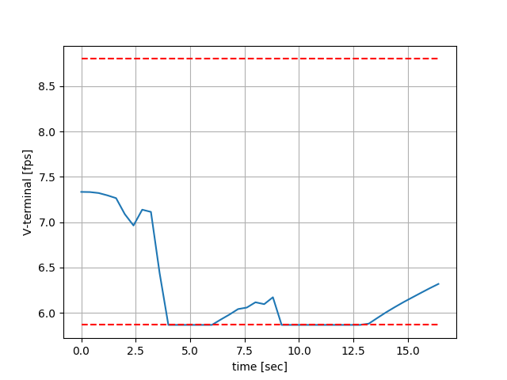
MPC Trajectory Satisfies Vehicle Constraints
Vehicle has a tendency of slowing down during the turns.
MPC constraints prevents the vehicle to slow down too much
N = 4, T = 0.4, ns = 4, no = 2
Corresponds to the turns to avoid the two obstacles

